Slide 1
Digital Portfolio
STUDENT NAME: SWATHY.M
REGISTER NO AND NMID: 212403925
DEPARTMENT: BCA COMPUTER APPLICATION
COLLEGE: TAGORE COLLEGE OF ARTS AND SCIENCE ,MADRAS UNIVERSITY

Slide 2
PROJECT TITLE
Digital portfolio

Slide 3


AGENDA
Problem Statement
Project Overview
End Users
Tools and Technologies
Portfolio design and Layout
Features and Functionality
Results and Screenshots
Conclusion
Github Link
3/21/2024 Annual Review

Slide 4

PROBLEM STATEMENT
Many students and developers struggle to showcase their skills, projects, and achievements in a professional format. A personal portfolio website solves this by providing an online platform to display work, making it accessible to recruiters, peers, and collaborators.

Slide 5

PROJECT OVERVIEW
This project is a personal portfolio website created under the Naan Mudhalvan programs
It highlights the student's background, skills, projects, and achievements. The website is simple, responsive, and easy to navigate. It also serves as a central hub to share links (GitHub, linkedIn, etc.) and project showcases.

Slide 6

WHO ARE THE END USERS?
Students & Freshers - to display skills and projects.
Recruiters / Hiring Managers - to quickly evaluate candidate profiles.
Peers & Collaborators to connect and collaborate on projects.
Mentors & Faculty - to review student progress.

Slide 7
TOOLS AND TECHNIQUES
Frontend: HTML5, CSS3, JavaScript
Version Control & Hosting: GitHub, GitHub Pages
Design Elements: Responsive layouts, modern Ul components

Slide 8
POTFOLIO DESIGN AND LAYOUT
The portfolio follows a clean, section-based layout:
Home Page - Introduction and welcome message
About Section - Personal background and interests
Skills Section - Technologies and tools mastered
Projects Section - Descriptions, screenshots, and links to projects
Contact Section - Email, GitHub, LinkedIn links
‹#›

Slide 9
FEATURES AND FUNCTIONALITY
Responsive design (works on mobile, tablet, and desktop).
Navigation bar for quick access to sections.
Project showcase with links to GitHub repositories.
Contact details and external links

Slide 10
RESULTS AND SCREENSHOTS
Successfully hosted live at:
swathy 43.github.io/
Naan-Mudhalvan-Portfolio
Fully functional sections with project highlights.
Screenshot examples can be taken from each portfolio section (Home, About, Projects).
3/21/2024 Annual Review
‹#›

Slide 11
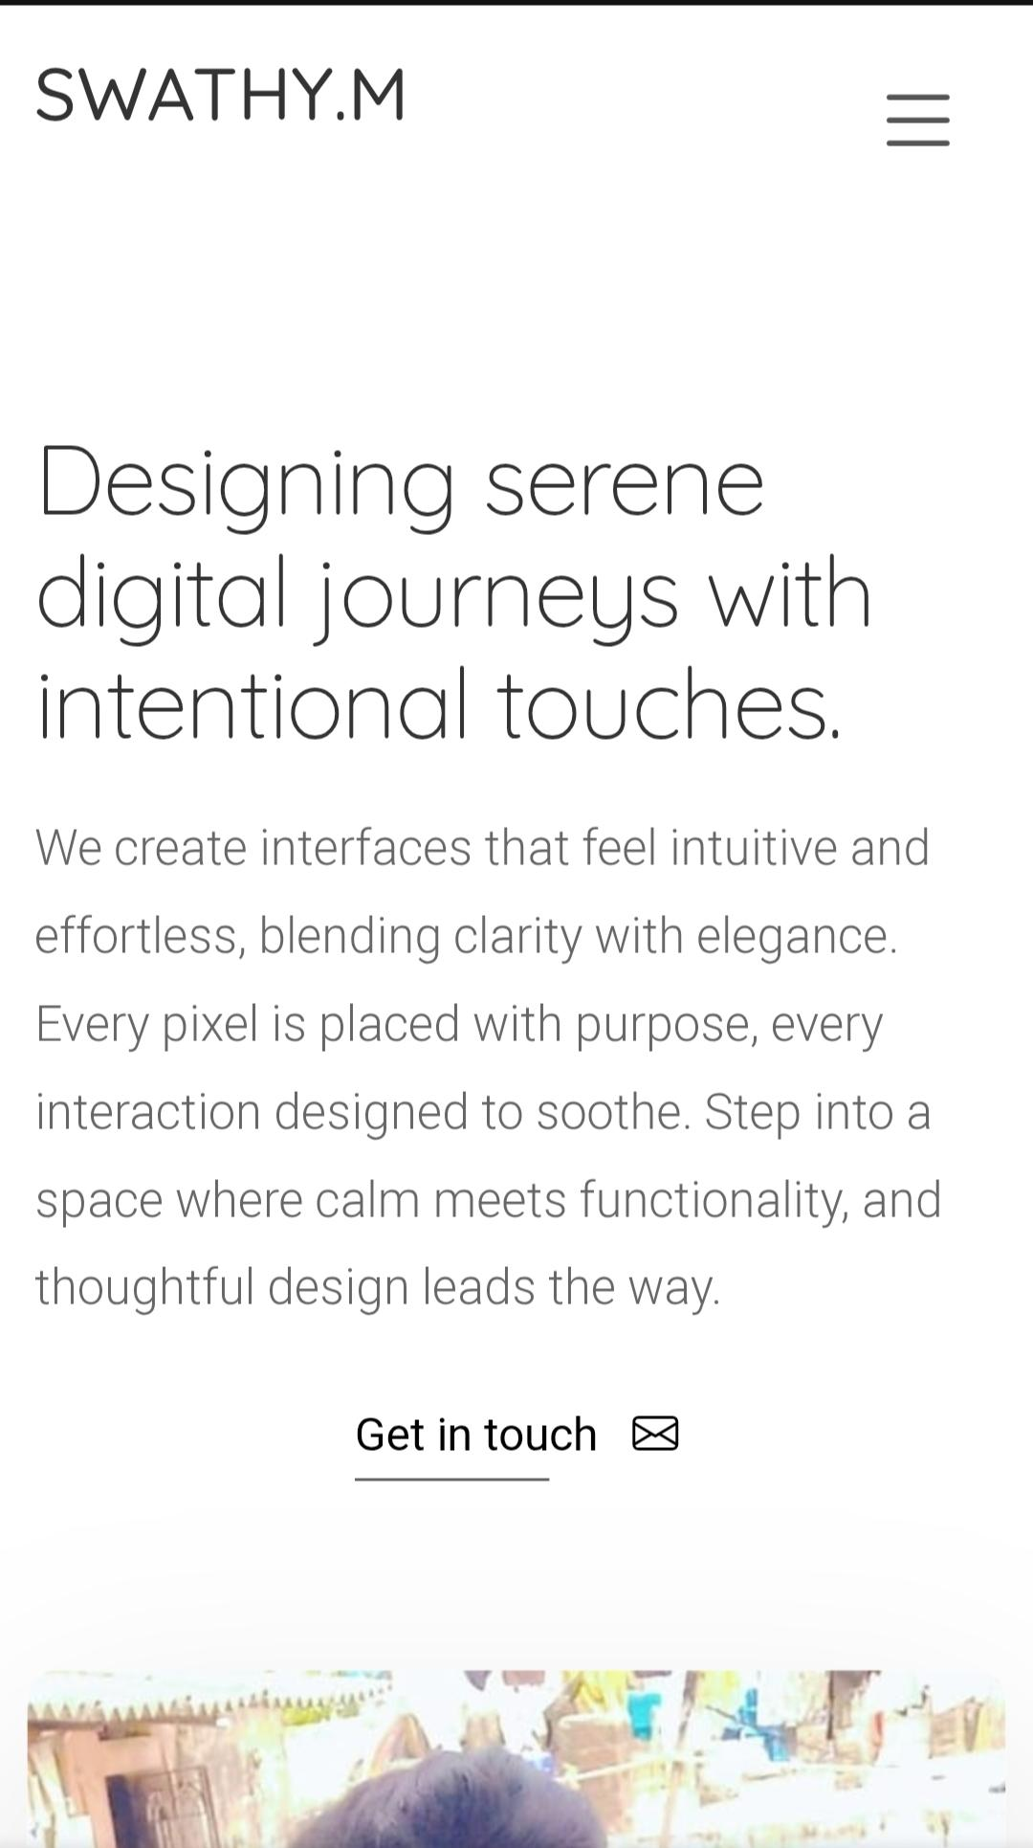
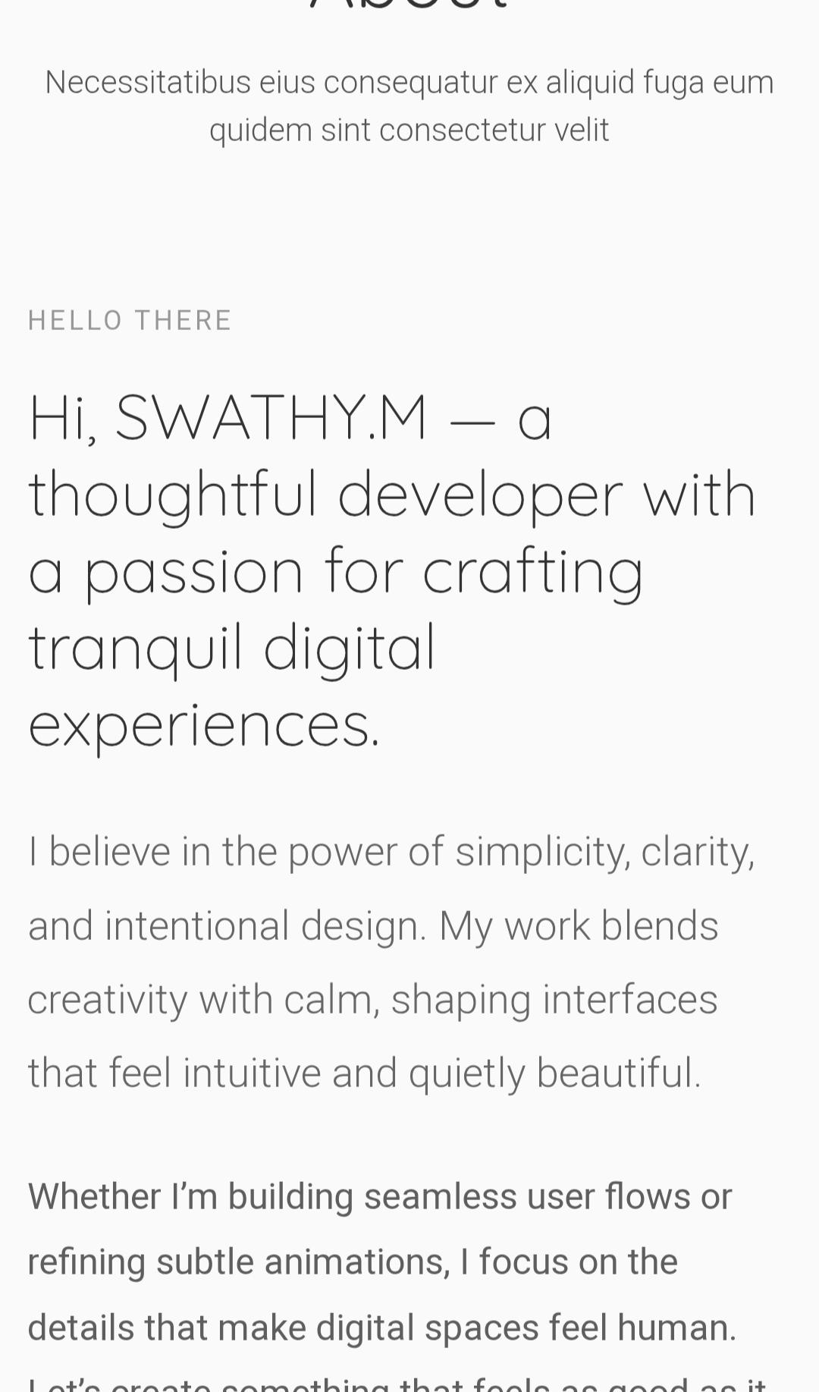
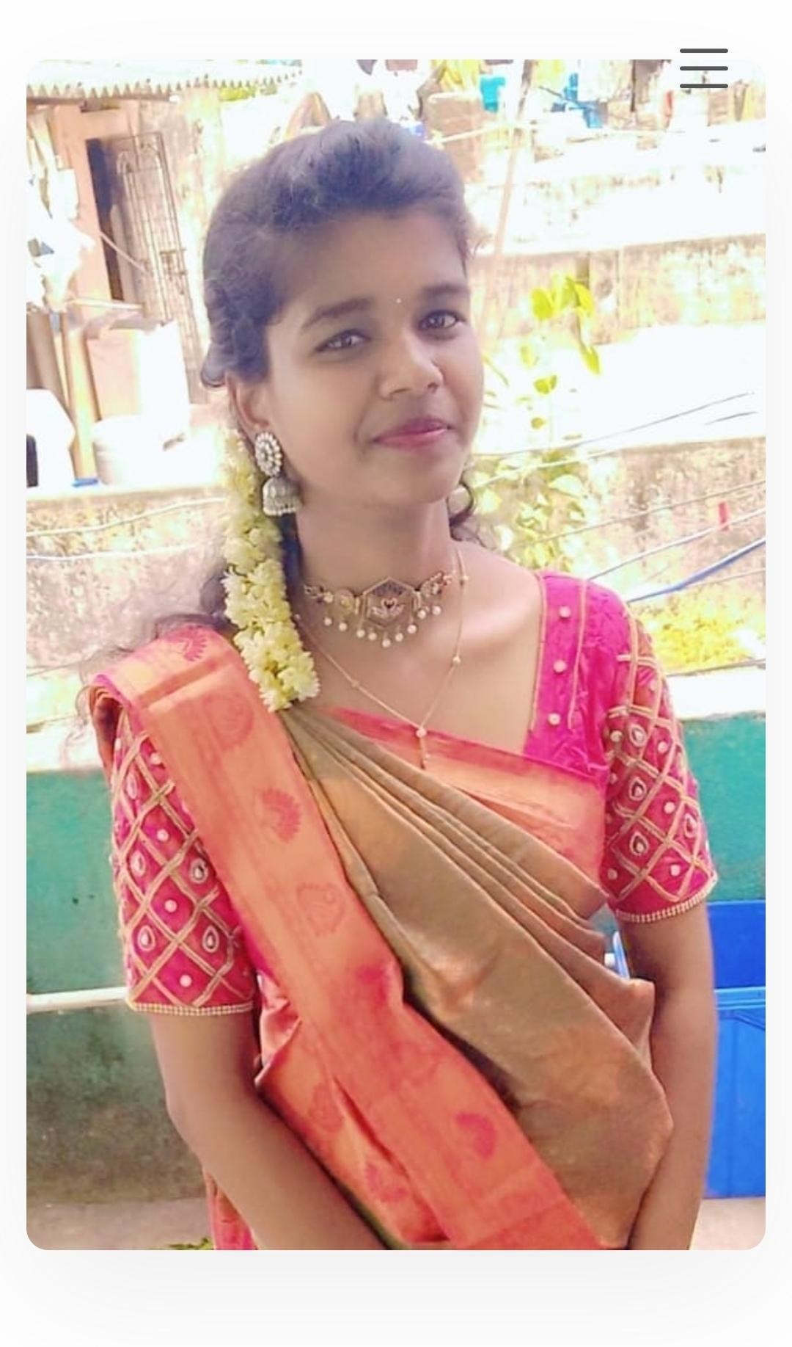

Slide 12
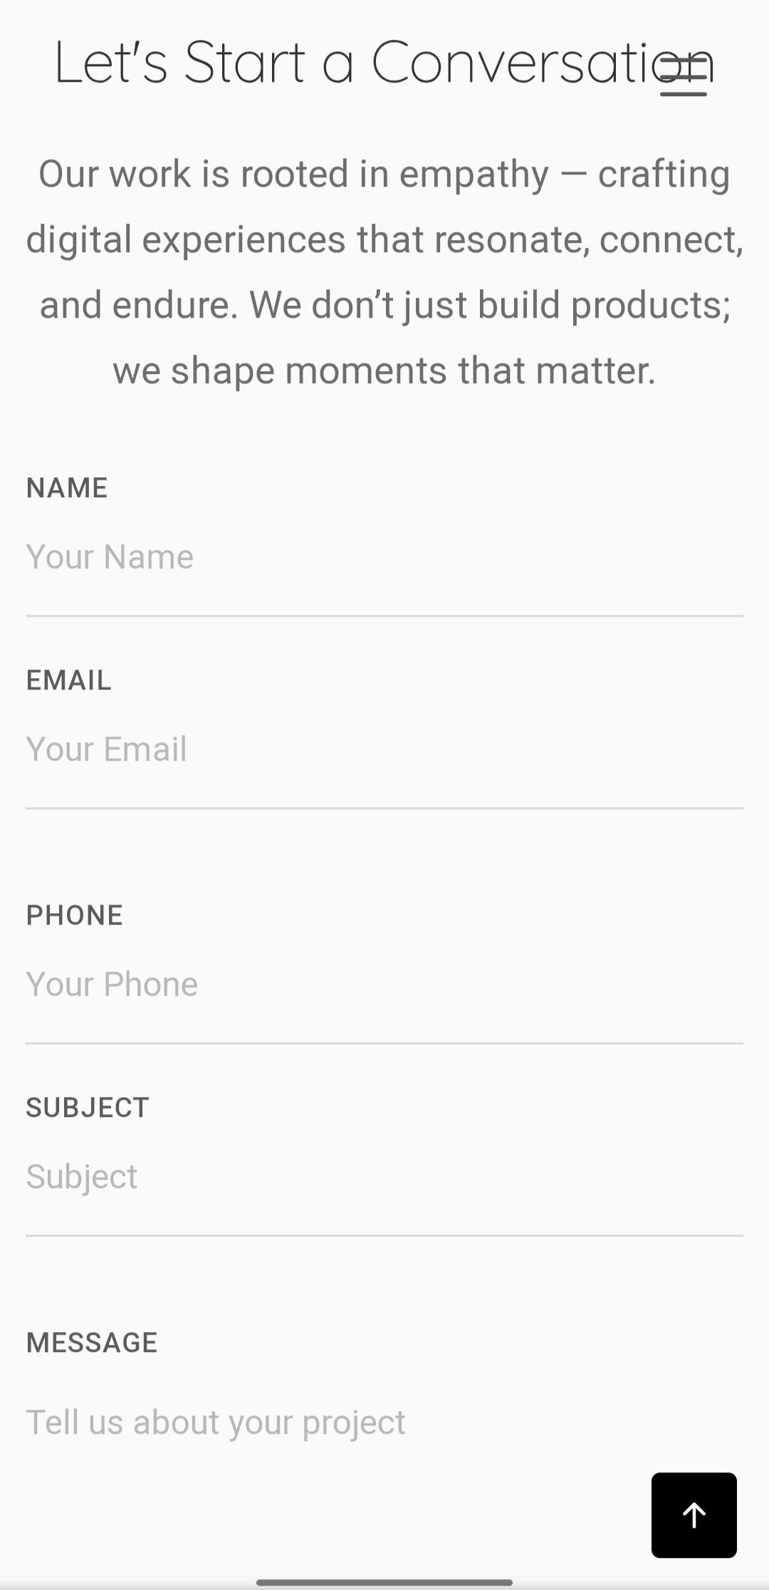
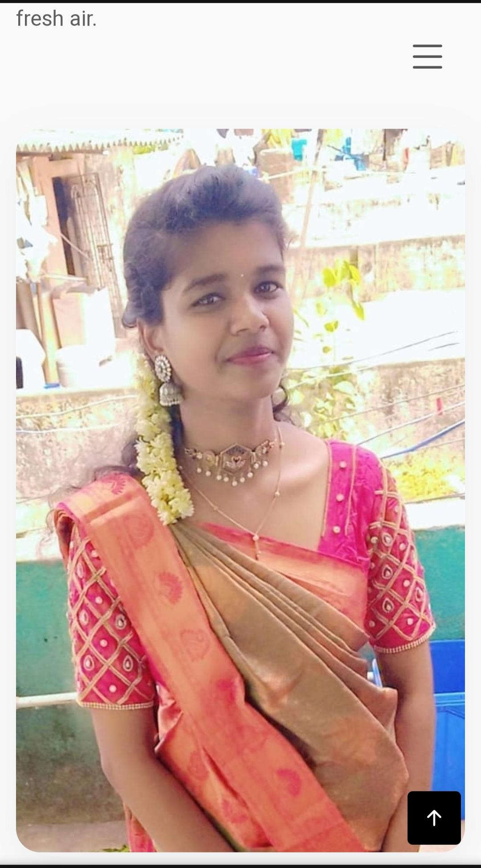
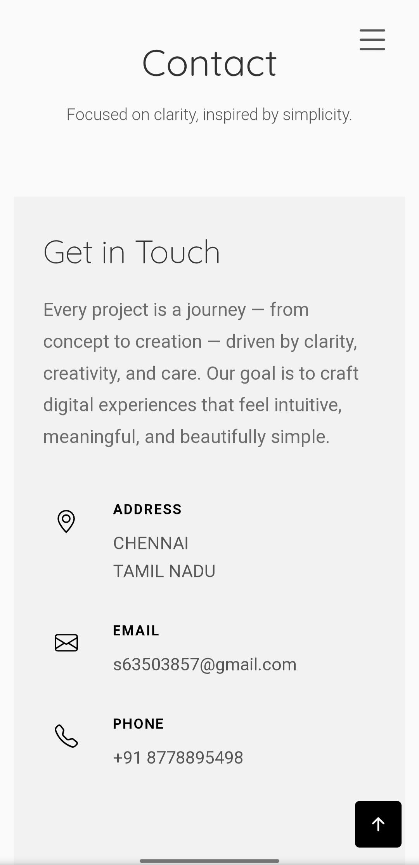

Slide 13
CONCLUSION
The Naan Mudhalvan Portfolio Project serves as a valuable digital resume, helping students present themselves professionally. It not only showcases technical skills but also demonstrates the ability to deploy a live project. This makes it an essential step for career growth in the Il field.
‹#›

Slide 14
GitHub link
Github link
https://github.com/swathy43

